Slide 1
Computer Fundamentals
د. محمد قايد
كلية الحاسبات والذكاء الإصطناعي – جامعة بني سويف

Slide 2
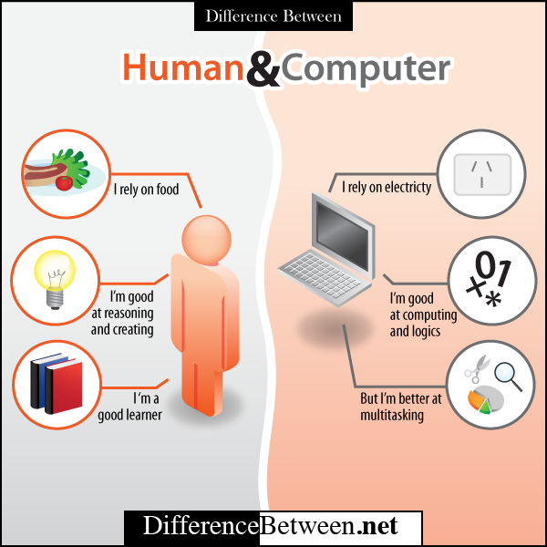

Slide 3
Computer Study
Software
Hardware
Input
CPU
Output

Slide 4
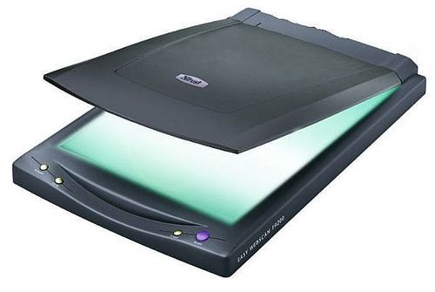
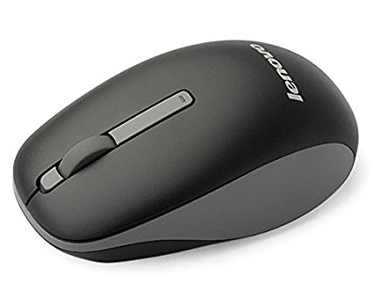
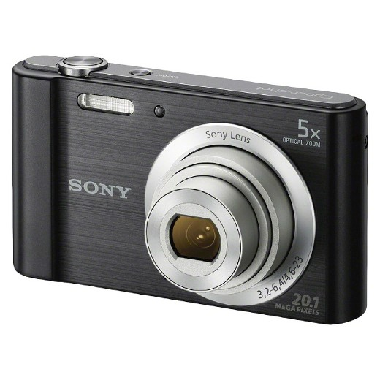
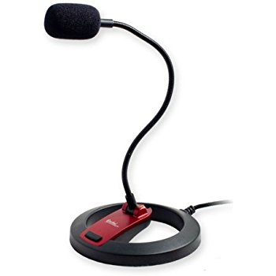
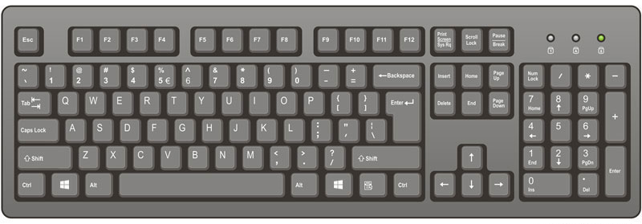
Computer Study
Software
Hardware
Input
CPU
Output
Keyboard
Mouse
Microphone
Scanner
Camera
…

Slide 5
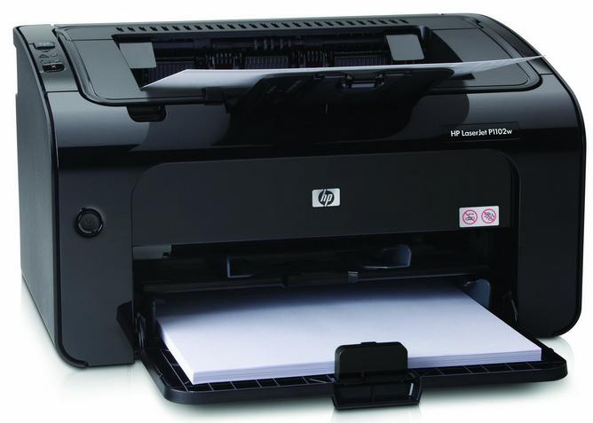
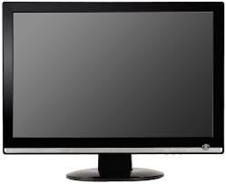
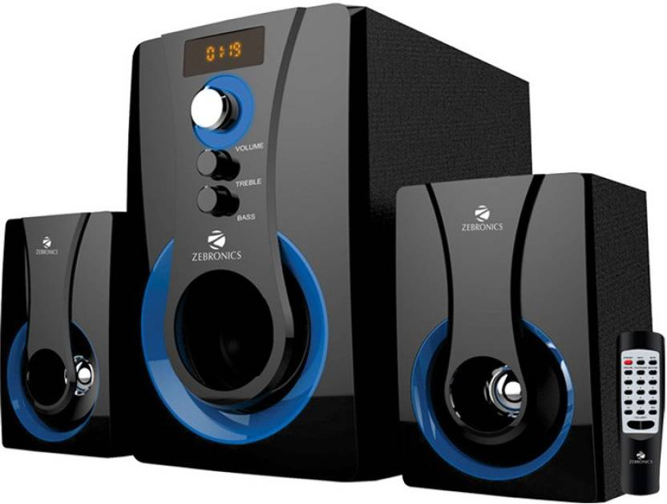
Computer Study
Software
Hardware
Input
CPU
Output
Monitor
Printer
Speaker
…

Slide 6
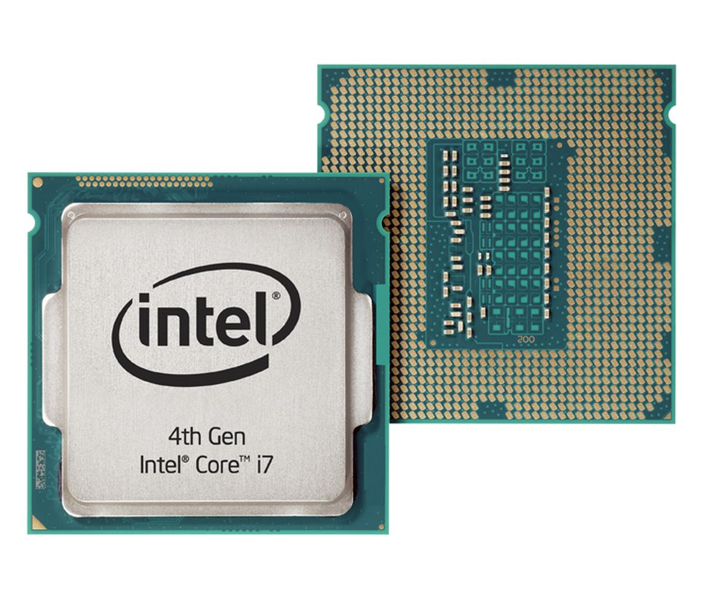
Computer Study
Software
Hardware
Input
CPU
Output

Slide 7
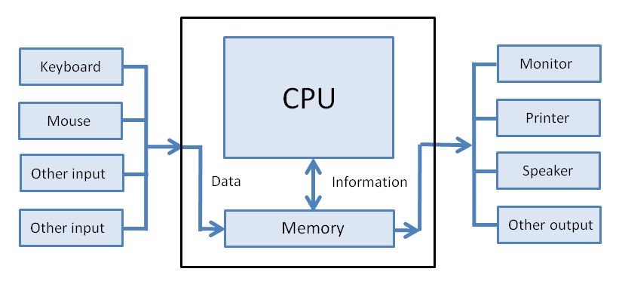
Processor

Slide 8
Human/User Language

Slide 9
Machine Language

Slide 10
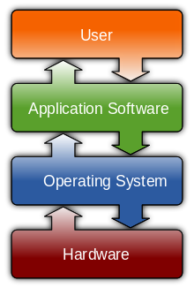
Computer Study
Software
Hardware

